Slide 1
Costa Rica
Uncovering the Mystery

Slide 2
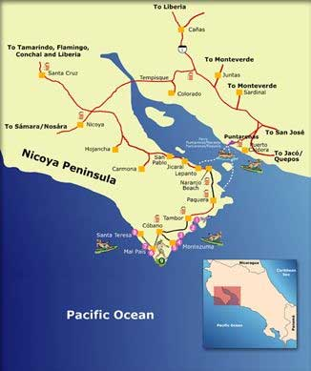

Slide 3
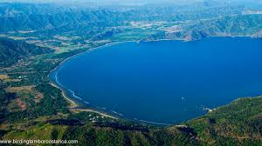

Slide 4
Third World Conditions
Poverty
War
Disease
Notes:
In spite of all of the challenges this country is healthier than other in Central America.

Slide 5
Central American Gem
Costa Rican Men age 60 , 2X as likely as a male in US to reach age 90.
Spend 85% less on health care
Men in general live much longer
Cancer rates 23% less
Notes:
With less spent on healthcare, they somehow are able to live longer and have less risks for many chronic health conditions.

Slide 6
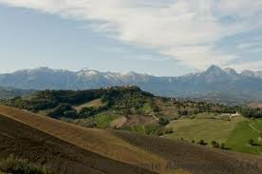
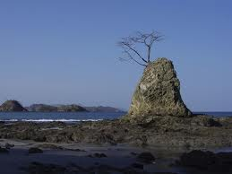
Sardinia
Isolation
Nicoya Peninsula
Notes:
Many similarities between Sardinia and the Nicoya Peninsula exist including a history of isolationism.

Slide 7
The Keys
Family
Food
Purpose
Faith
The Sun
The water

Slide 8
Health care best in CA
Good immunizations programs, clinic
Best Sewage and Water
Relationships
Marriage very important, but promiscuity accepted
Cancer
Countries lowest cancer rate, mortality rate much lower
Your thoughts
Notes:
Aside from a lifestyle that supports good health, Costa Rica residence have access to prevention programs including immunizations and water treatment.

Slide 9
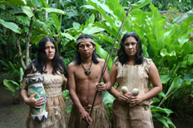
Chorotega Indians
Notes:
Many of the practices of the Chorotega Indians are continued in present day.

Slide 10
Simple living
Home Gardens
Corn and Beans, some fish/meat
Very Religious
Stress Management
We all have stress in our lives; management is key!
Notes:
These are the five hallmarks of the Nicoya Lifestyle. Stress management is key. The realities of stress can affect us all, but they have a unique way of shedding stress.

Slide 11
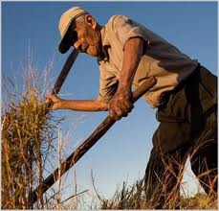
Natural movement
Sun
Purpose
Notes:
Working outside in the garden adds to health in multiple ways including physical activity and vitamin D.

Slide 12
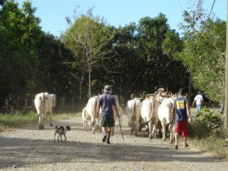
Physical work and the enjoyment they receive from it is one key reason why the locals live longer
Notes:
Happiness and purpose through their work helps to reduce stress.

Slide 13
Physical Activity
Meal Preparation
Chores – Hard Work
Daily walking
Notes:
Simple conveniences we have in the US are not available there, this adds to their daily activity. For instance, women make their own tortillas, clean their homes and walk where they need to go.

Slide 14
Dr. Oz :
If you can’t walk a quarter-mile in five minutes, the chance that you’ll be dead in three years is three times higher than if you can,” he says. “It’s a big deal.”
Notes:
I wonder how many Americans can do this.

Slide 15
Powerful Anti-oxidants
Notes:
Many of their dietary mainstays contain a vast amount of antioxidants. These have been shown to help cells stay healthy.

Slide 16
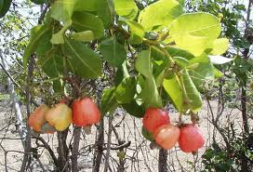
Maranon fruit – Vitamin C
Notes:
This fruit grows wild and has more vitamin C than most fruits. Maranon is an unusual fruit. Its seed, the cashew nut, The ripe fruit can be eaten or made into a refresco (shakes) or fermented into wine. The dried fruit is like a cross between a prune and a fig and is sold in supermarkets.

Slide 17
Fruits
Beans
Maize
Notes:
With these low calorie, high nutrient choices Costa Rican diets support good health.

Slide 18
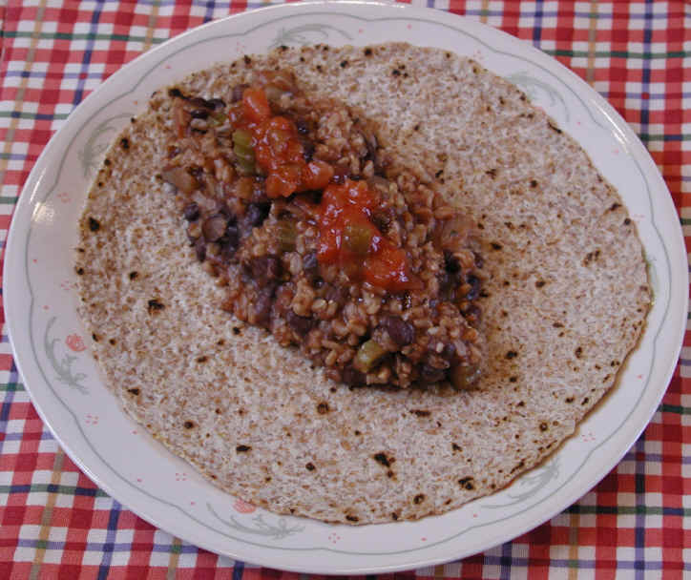
Nicoyan diet is that they tend to eat their larger meals in the morning, with progressively smaller meals throughout the day
Notes:
Not only the content of their meals but when they eat their larger meal significantly differs from practices in the US

Slide 19
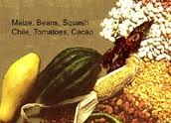
Mesoamerican trifecta
Corn, beans, squash
Notes:
But the real secret may be in what Buettner calls the "Mesoamerican trifecta" that is the predominant diet in much of Central America — and has been for 3,500 years. The diet consists of lightly salted corn tortillas, beans and squash. "It's arguably the best longevity food ever invented," Buettner said.

Slide 20
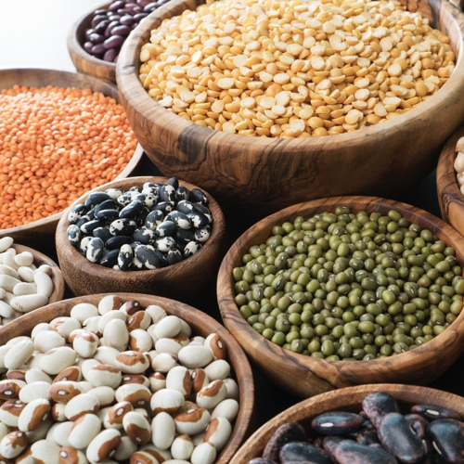
The Power of Legumes
A part of each of the world’s healthiest diets.
Rich in phytonutrients, antioxidants, and accessible to all economically.
High in fiber, iron, folate, magnesium, phylates, vitamin B6 etc.
Serves as a protective element for many diseases including cancer diabetes.

Slide 21
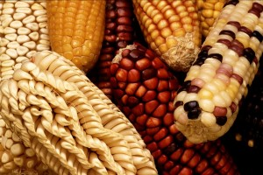
Nutrients
Maize
Tends to be low on glycemic index
High in potassium
Pantothenic acid:
Folate
Vitamin B 6
Niacin
Corn in the US is Genetically modified

Slide 22
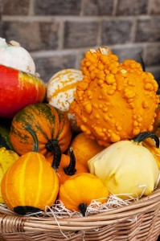
Squash
he Mesoamericans utilized practically all parts of the plant, eating them either cooked or raw, but the most important part of the squash was the seeds, which could be boiled, or baked then ground into powder to make sauces or added to water or juice.
Antioxidant rich
Lowers blood sugar
Ant inflammatory
Promotes optimal health

Slide 23
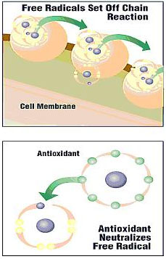
Anti-oxidants
Inflammation
Healthy diet provide protection and helps prevent chronic diseases.
Notes:
To learn more about anti-oxidants go to:
http://www.bing.com/videos/search?q=antioxidents&qs=n&form=QBVR&pq=antioxidents&sc=8-12&sp=-1&sk=#view=detail&mid=B487330FB9D59591697DB487330FB9D59591697D

Slide 24
Water
Hard water
How can we do this?
“Calcium, magnesium and water-it relaxes your arteries, it builds bone strength and it has a huge benefit across the board in how your body functions,” Dr. OZ
¼ less heart disease
Eat eggs and dairy.
You can get calcium from other sources too, including leafy green vegetables like kale and broccoli.
Notes:
Buettner said one of the secrets of Nicoyans' lifespan can be found in the water that flows through the hills. Their water is among the hardest in Costa Rica—which means it's chock-full of minerals. "Hard water means stronger bones. It also means your muscles are probably working better, especially when you get old," he said.
Dr. Oz said hard water has proven benefits. "Calcium, magnesium and water—it relaxes your arteries, it builds bone strength and it has a huge benefit across the board in how your body functions," he explained.

Slide 25
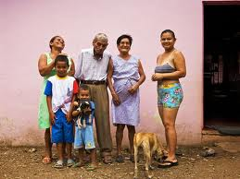
Marriage and Relations
Marry
Push to stay
Other Relationships
Just move in don’t divorce
Notes:
Marriage and family are important, but monogamous relationships are not always the case. Having other relationships outside of the marriage is accepted, but not divorce.

Slide 26
Video
The keys to longevity in Costa Rica
Don Faustino

Slide 27
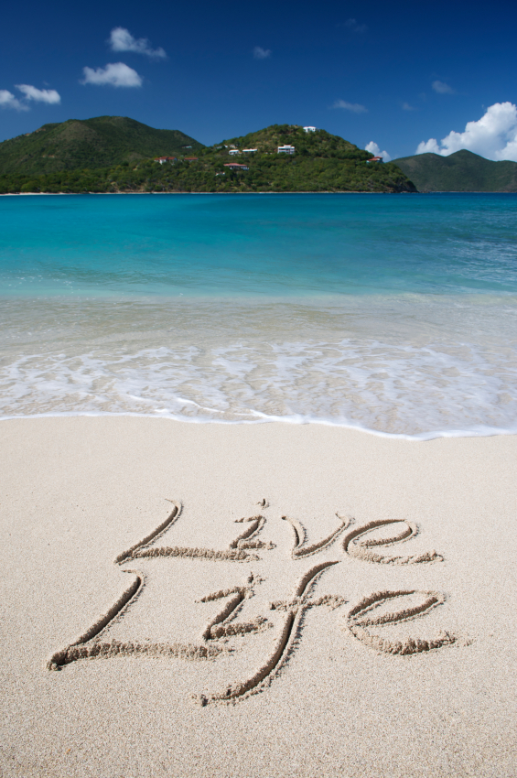
How does the US philosophy of life differ from that of those in
The Nicoya peninsula?
Do we run our lives are does our life run us?

Slide 28
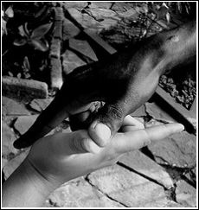
Kenzoku – Family/Friends
Bond -similar-similar commitment possibly share a similar destiny.
Unbroken by time or distance
Characteristics:
  Common interests
  History
  Common values
  Equality
Who are they?
  Commitment to your happiness
  Friendship does not compromise values or principles
  Good influence
  Undetermined attraction
  Feels like home
Priceless Gems

Slide 29
Gandhi: "Be the change you wish to see in the world." Be the friend you want to have.
Notes:
How can you change your life to demonstrate this thoughtful quote.

Slide 30
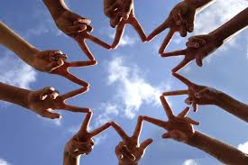
Attracting Friends
Be a big target
Join
Volunteer
Explore the internet
Take action
Notes:
Why do others flock to see Pancita? What makes her so special?

Slide 31
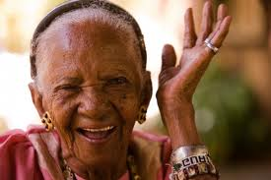
Lessons From Panchita
Support Group/Safety Net
Power of Positive self-talk
Positive Karma
Belief in a higher power
Finding peace and happiness where you are
Learning from tough times

Slide 32

Simple Meal – Profound lesson. She gave when she had so little…but received in return.
Giving is powerful
Find contentment
Be positive

Slide 33
Pancita
Why are people of all ages drawn to her?
What was special about the meal she offered to her guests?
How has she survived and thrived in difficult situations?
What about her can you apply to the way you live your life?

Slide 34
Dan Faustino-His River of Life
What about him reflected conscientiousness?
    Explain four elements in detail
What was important about his trip to the market each week?
How did he describe his marriage and other relations? What about his approach is the same of different to that in our country?
In his mind his life was tranquil, what were the components of his tranquility.

Slide 35
Rising, eating and Sleeping
Up with the sun
Eat a large lunch
Settling into rest after sunset
  Large lunch: lets them transition into sleep much more easily when darkness falls. “A hundred years ago, when the sun went down, the brain would start making more melatonin. And with more melatonin, you’d get tired, you’d get drowsy. We do just the opposite .
Notes:
Our natural tendency is to rise with the sun and go to bed hen it sets. We have taught ourselves a different approach.

Slide 36

Safety Net
Family/Friends
Notes:
The access to friends and family during tough times enables them to feel that everything will be OK. Pancita is a prime example of this.

Slide 37
In Review:
What Is Unique
Compare and contrast Sardinia and Nicoya Peninsula in terms of:
  Gene pool
  Dietary stables
  Family
  Other

Slide 38
Traditional Marriage and Family Values
Compare marriage and family values in the US with those in Nicoya Peninsula?
How does the value system affect the family dynamic?
How is the strong sense of service displayed in the life of Dan Faustino? To what is his sense of service linked?

Slide 39
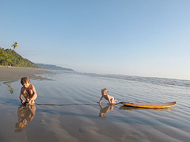
Simply Living: Is that possible here?
See notes below and respond on open forum
Notes:
Open Forum: How can we, in the US, start to live a simpler life and have less stress.? What could you do without, that would allow you to do this?

Slide 40
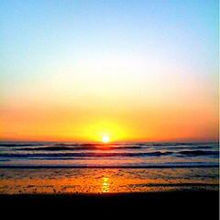
In spite of simple life, it is never boring
Notes:
Do you get bored in spite of all that you have and have access to? Why?

Slide 41
Longevity Secrets
Sense of purpose: Simply put
Hard water: Calcium/Magnesium
Family Focus
Light Dinner
Social safety net
Keep hard at work (that you enjoy)
Sensible Sun
Dietary essentials: Plants, little meat, natural.
Notes:
Basics from Nicoya.

Slide 42
In case you missed it
CNN video Pancita

